Slide 1
Cloud Skills Challenge
KUBERNETES BOOTCAMP

Slide 2
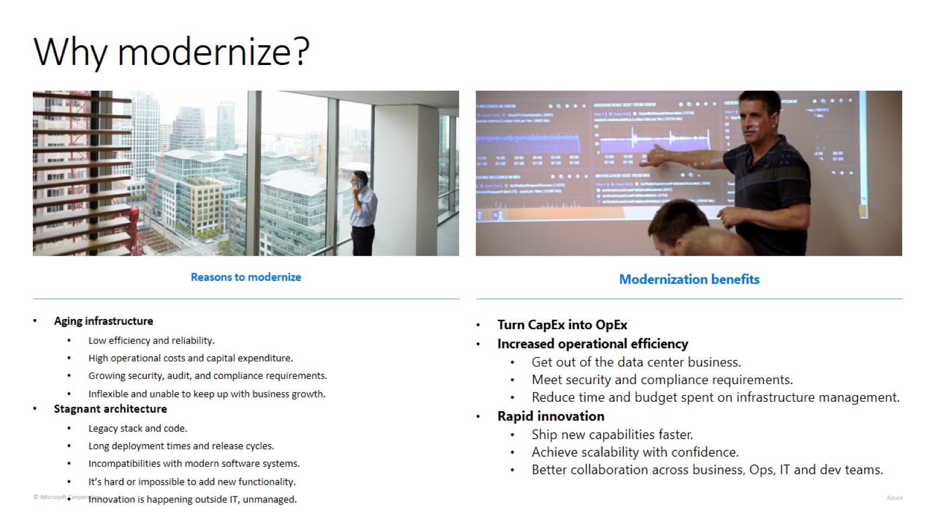
Why modernize?

Slide 3
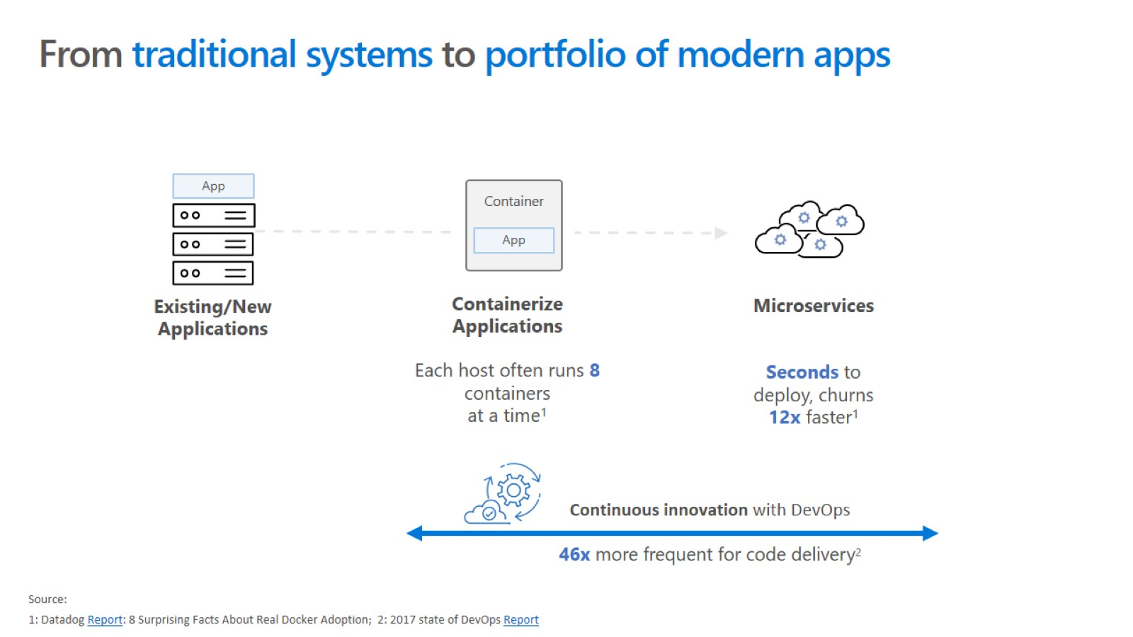

Slide 4
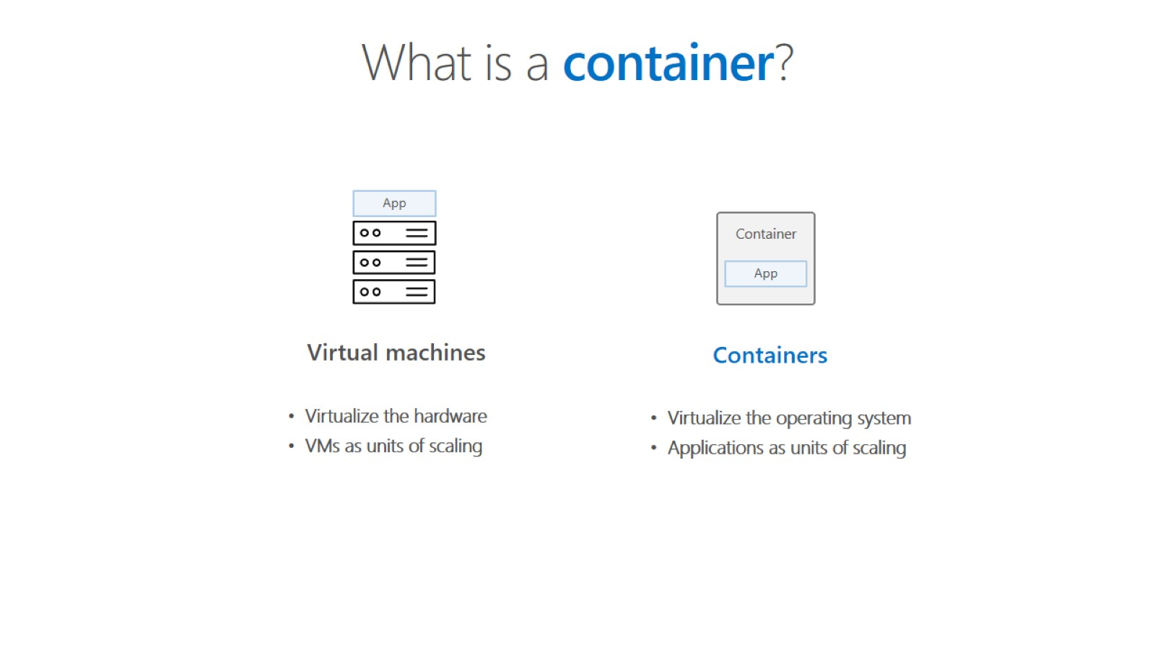

Slide 5
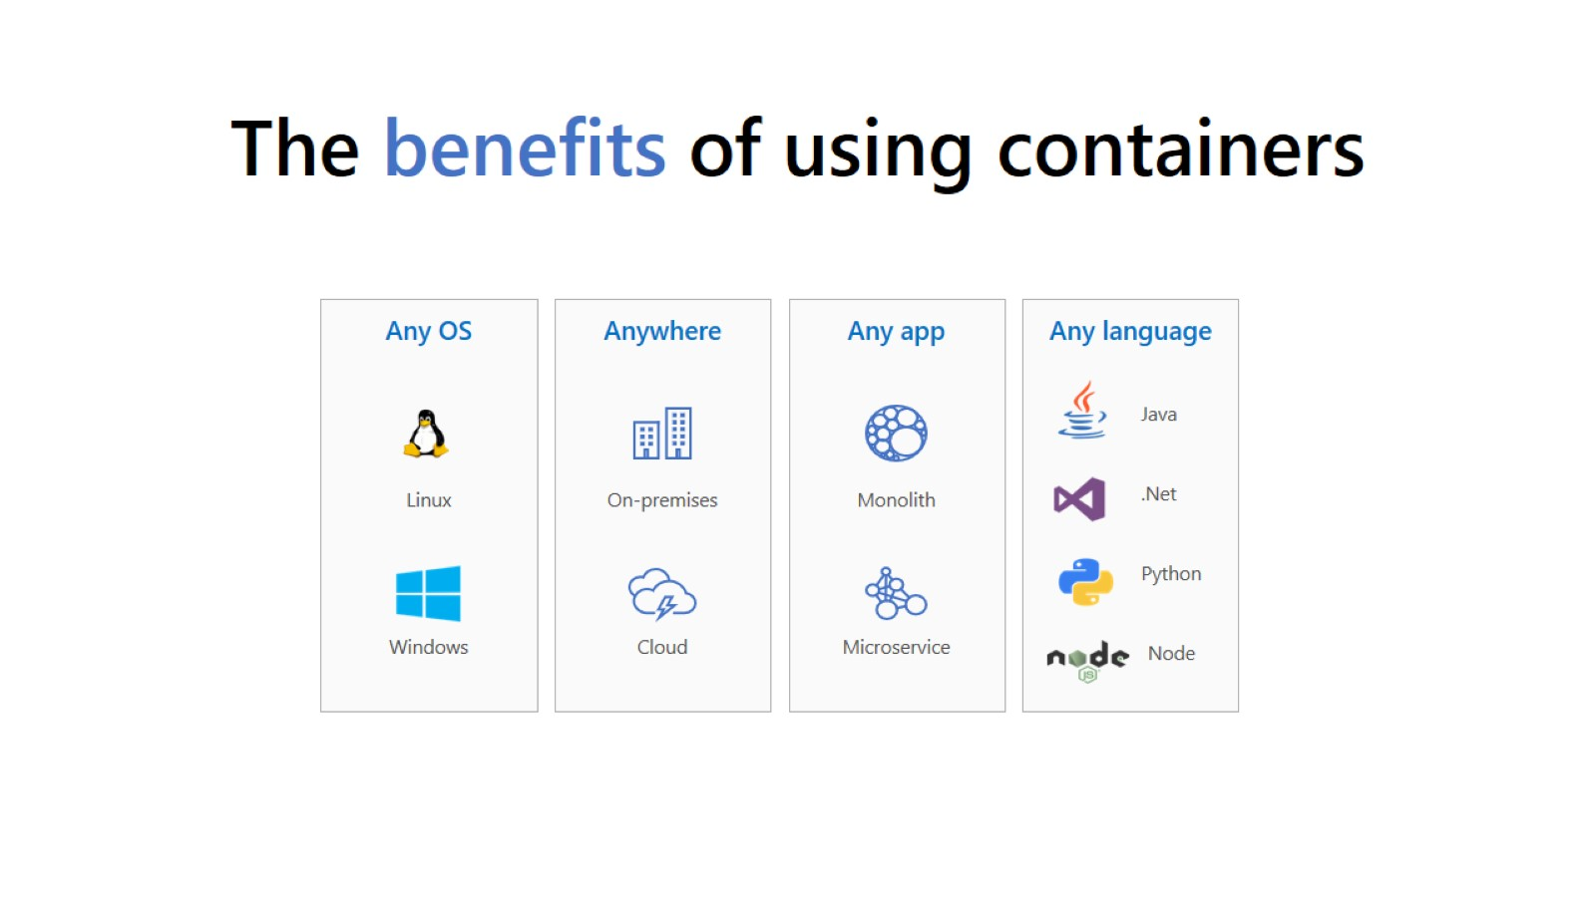
The benefits of using containers

Slide 6
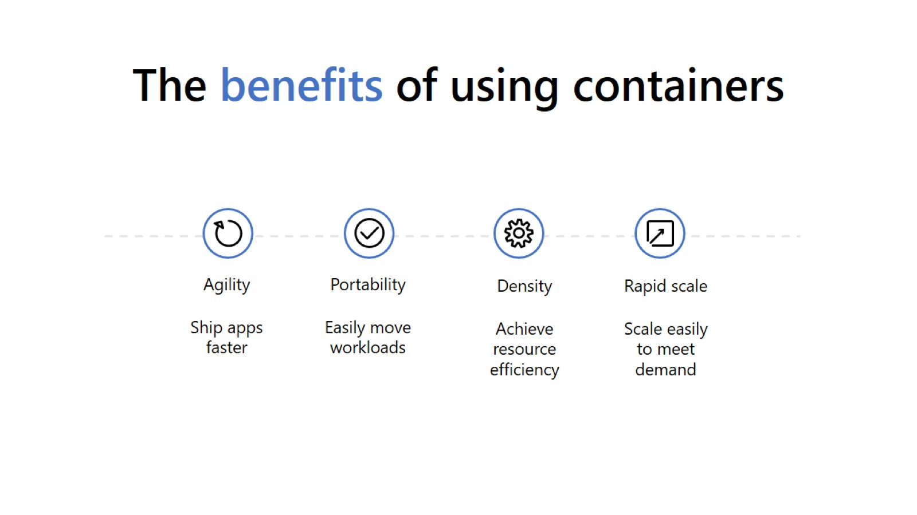
The benefits of using containers

Slide 7
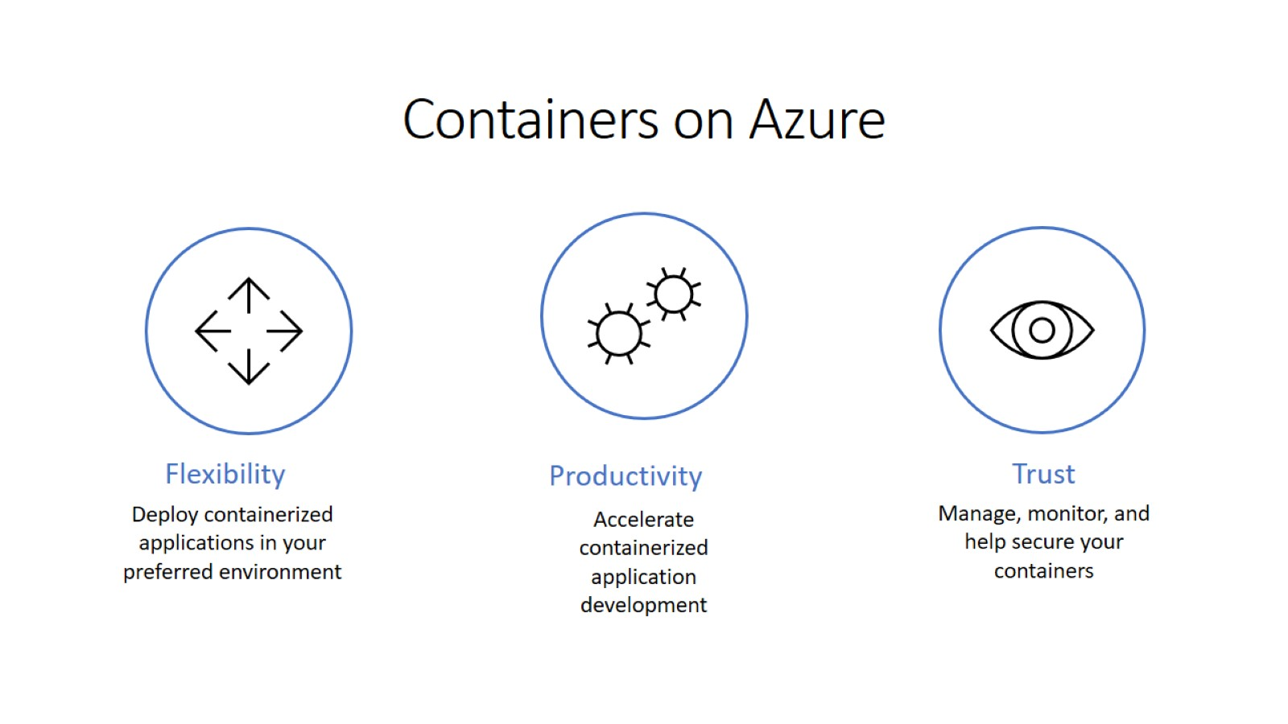

Slide 8
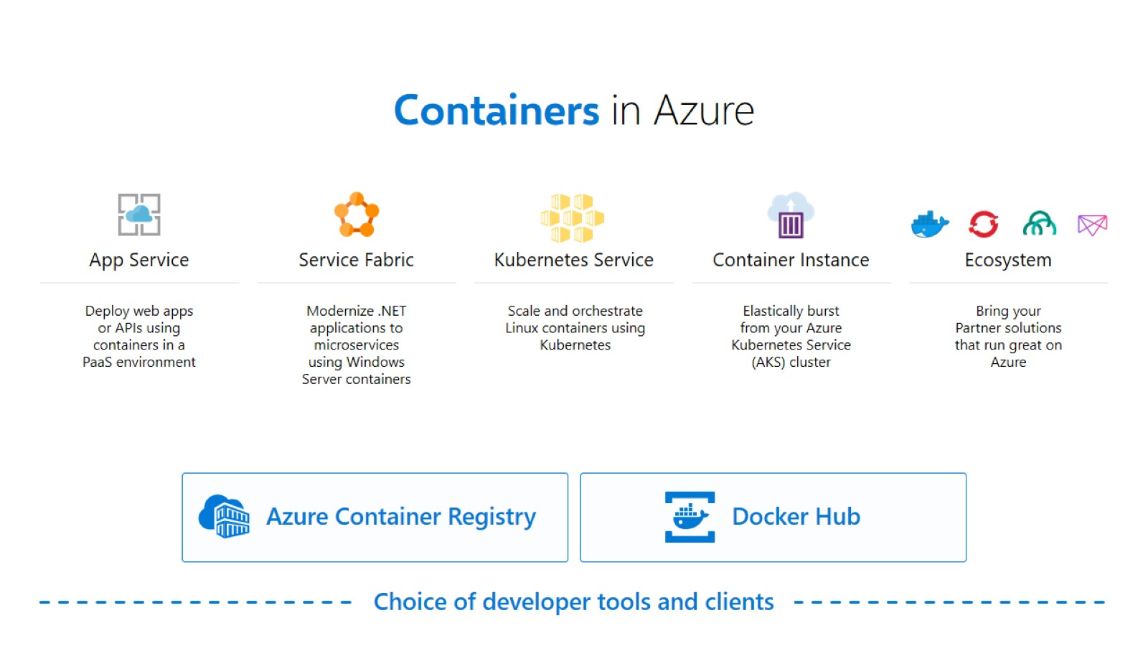

Slide 9
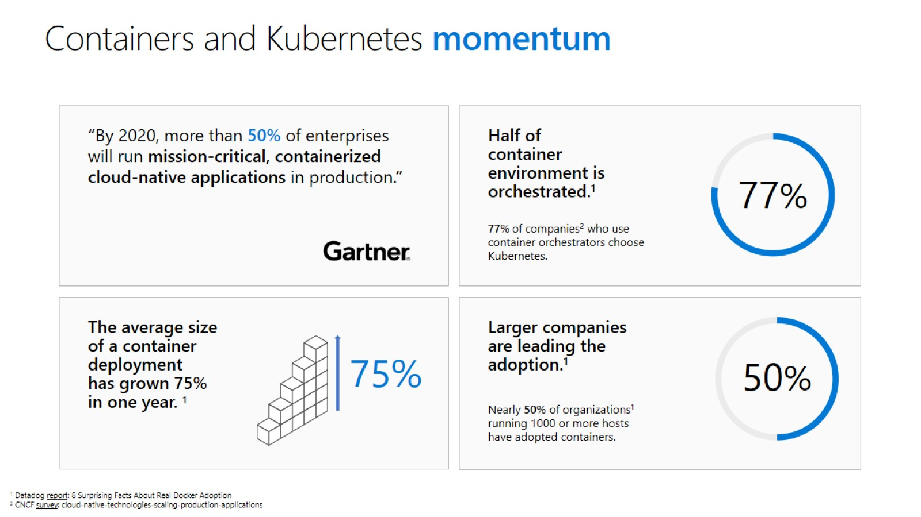

Slide 10

Kubernetes: empowering you to do more
Portable
Public, private, hybrid, multi-cloud
Extensible
Modular, pluggable, hookable, composable
Self-healing
Auto-placement, auto-restart, auto-replication, auto-scaling
Deploy your applications quickly and predictably
Scale your applications on the fly
Roll out new features seamlessly
Limit hardware usage to required resources only
Notes:
Kubernetes é hoje em dia o orquestrador mais usado no mercado.

Slide 11
The elements of orchestration
Scheduling
Affinity/anti-affinity
Health monitoring
Failover
Scaling
Networking
Service discovery
Coordinated app upgrades
Notes:
orchestration: perceber como é que os containers falam uns com os outros visto que coisas como o endereço de IP está constantemente a mudar.
Scheduling: quando um container vai abaixo, como é que mantemos o estado desejado?
- isolation: como é que garantimos a integridade de cada container, mesmo quando outros falham?

Slide 12
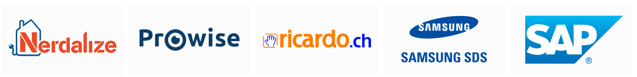



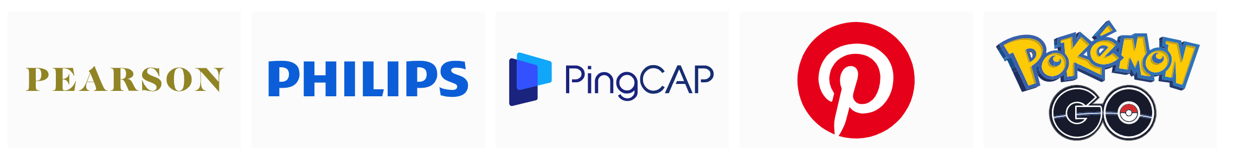

Slide 13
Kubernetes Architecture
Internet
Kubernetes control
Worker node
kubelet
kube-proxy
Master node
Docker
Azure managed control plane
Prod
Prod
API server
Containers
Containers
-controller-manager
-scheduler
Worker node
kubelet
kube-proxy
replication, namespace, serviceaccounts, etc.
etcd
Docker
Prod
Prod
Containers
Containers

Slide 14
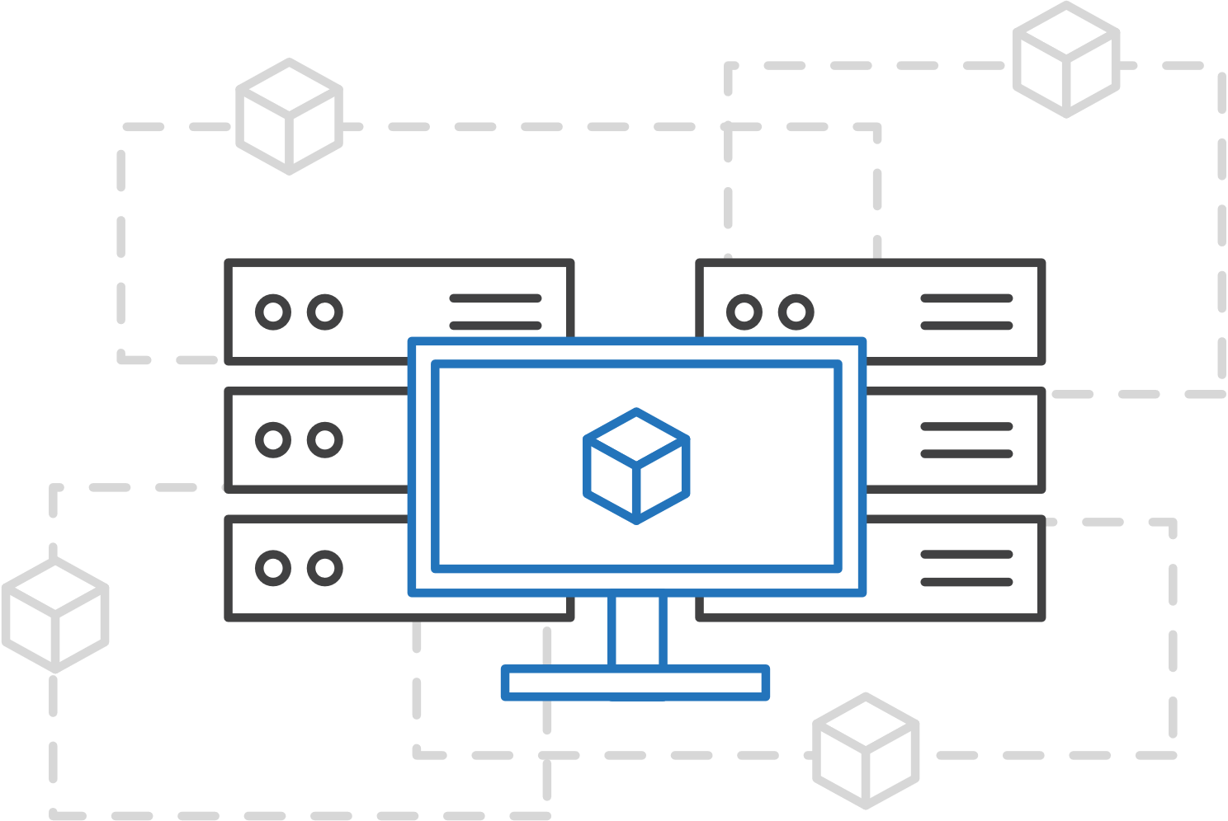
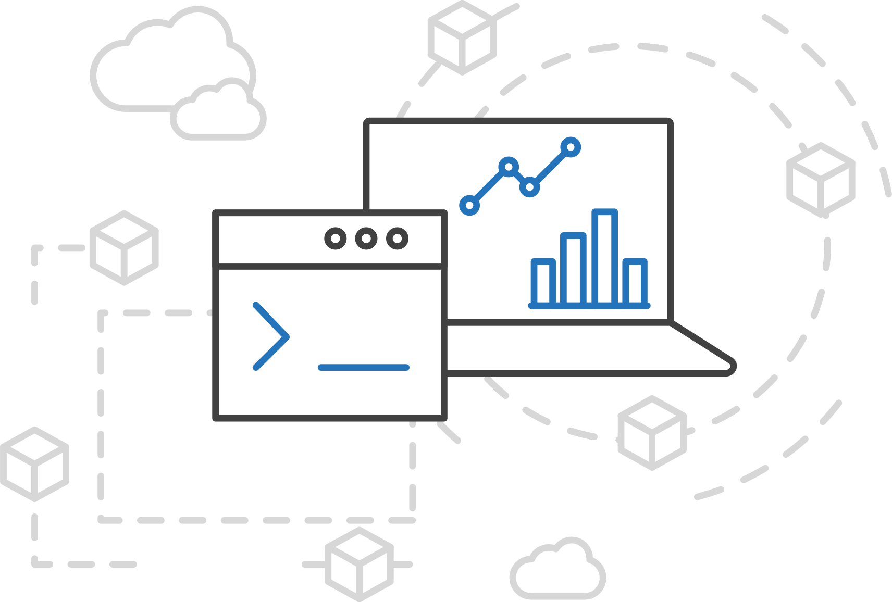
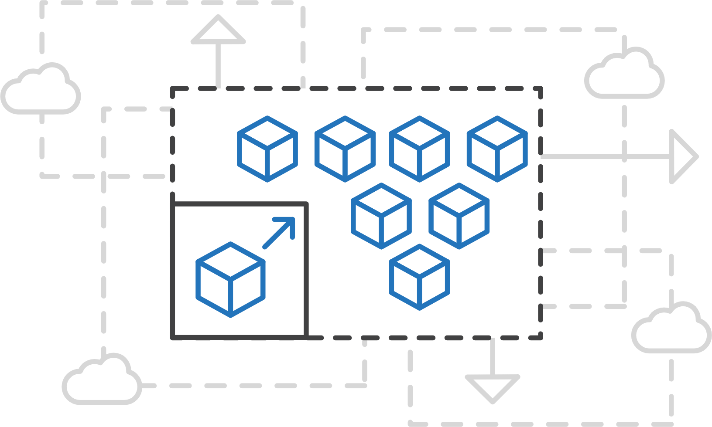
Azure Kubernetes Service (AKS)
Simplify the deployment, management, and operations of Kubernetes
Focus on your containers not the infrastructure
Work how you want with open-source APIs
Scale and run applications with confidence
Notes:
AKS reduces the complexity and operational overhead of managing Kubernetes by offloading much of that responsibility to Azure. As a hosted Kubernetes service, Azure handles critical tasks like health monitoring and maintenance for you. In addition, the service is free, you only pay for the agent nodes within your clusters, not for the masters.

Slide 15
Azure Kubernetes Service (AKS)
A fully managed Kubernetes cluster
Managed
Application architect
Applications
Operations
Kubernetes
Infrastructure architect
Docker
Azure infrastructure services

Slide 16
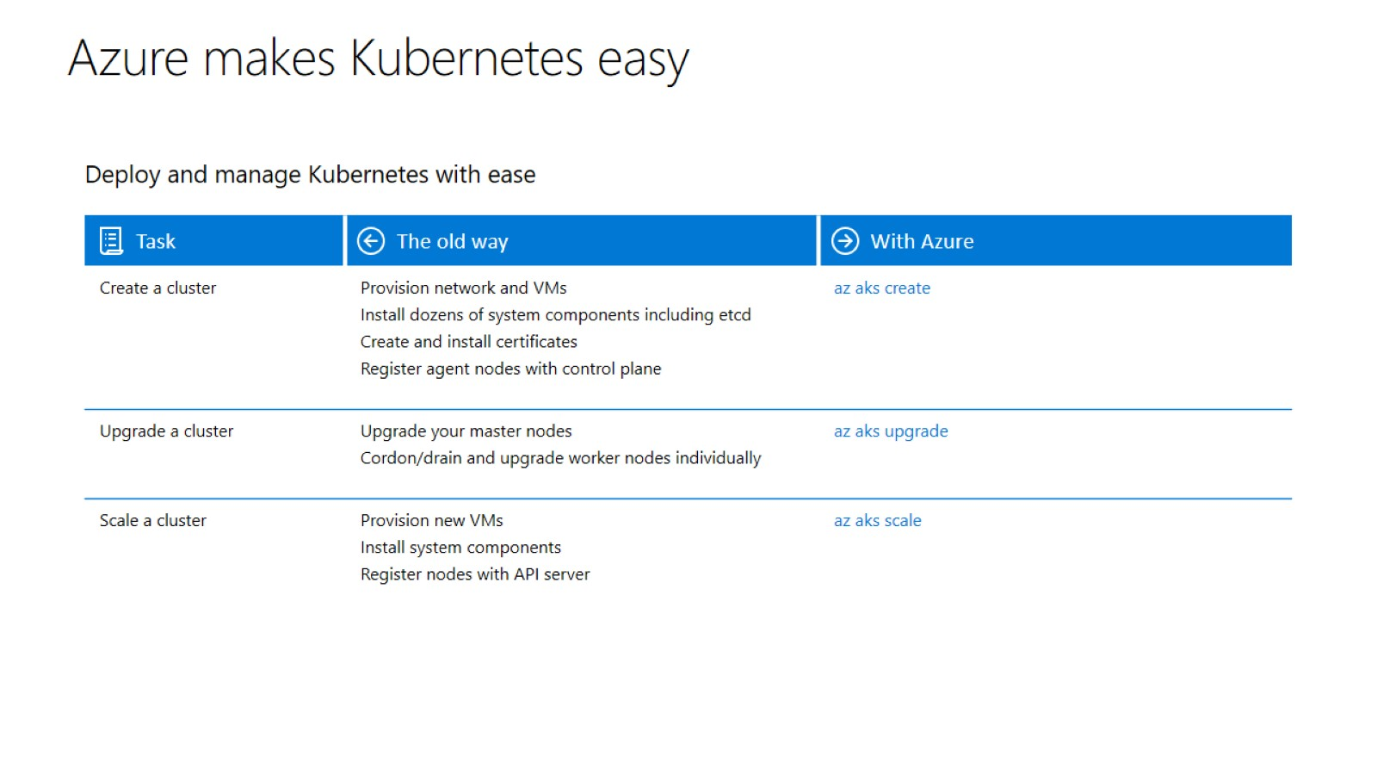

Slide 17
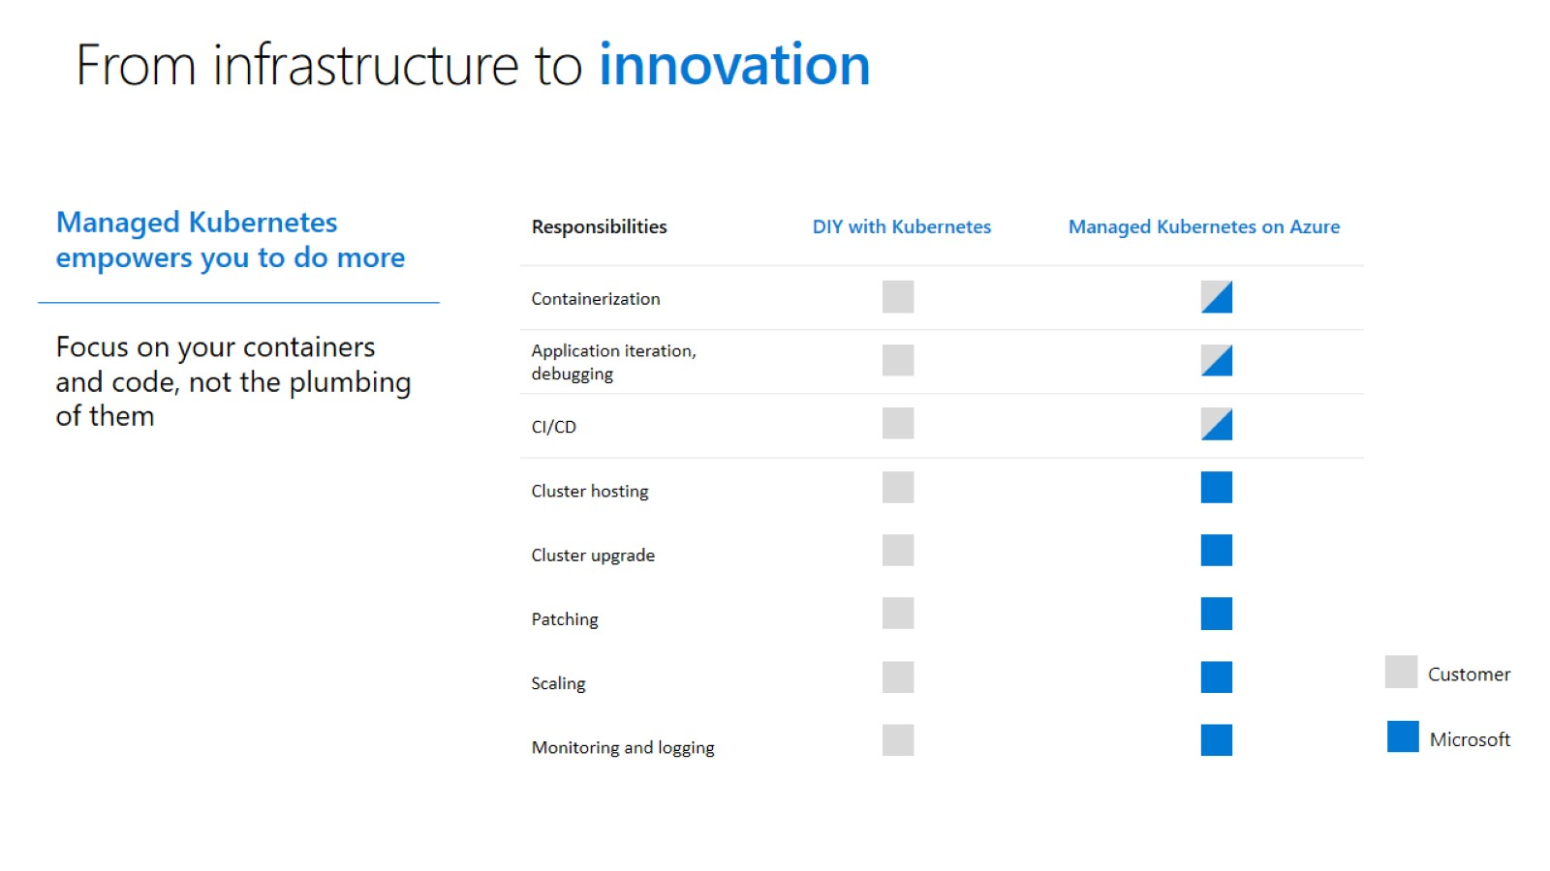

Slide 18
How to create your first cluster?
Notes:
ACR is a “private” Docker repository.

Slide 19
Kubernetes Resources

Slide 20
Kubernetes Resources
pod
ReplicaSet
deployment
service
namespace

Slide 21
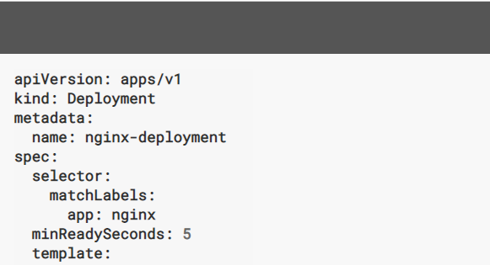
Declarative vs. Imperative
Commands like kubectl run and kubectl expose are imperative commands (do this thing now)
Declarative way – Describe the state of resources in a file (JSON or YAML). kubectl apply –f webresource.yaml
Notes:
In declarative model we are not telling Kubernetes how to get to the desired state from the actual state.
We are just telling it this will be my desired state

Slide 22
What is a pod?
Pod is the basic building block in Kubernetes
Pods are how containers are delivered
Can be multiple containers (e.g. side car)
Encapsulates container(s), storage, network IP, and options on how to run
Content Manager
Consumers
File Puller
Web Server
Volume
Pod
Notes:
We have learned that Kubernetes is an orchestration system to deploy and manage containers. Containers are not managed individually; instead, they are part of a larger object called a Pod.
A Pod consists of one or more containers which share an IP address, access to storage and namespace. Typically, one container in a Pod runs an application, while other containers support the primary application.

Slide 23
What is a pod? Considerations..
Pods do not, by themselves, self-heal!
If a Pod is scheduled to a Node that fails, or if the scheduling operation itself fails, the Pod is deleted; likewise, a Pod won’t survive an eviction due to a lack of resources or Node maintenance.
Thus, while it is possible to use Pod directly, it’s far more common in Kubernetes to manage your pods using a Controller.
Controllers can create and manage multiple Pods, handling replication and rollout and providing self-healing capabilities at cluster scope.
For example, if a Node fails, the Controller might automatically replace the Pod by scheduling an identical replacement on a different Node.

Slide 24
What is a pod?
Examples of Controllers that contain one or more pods:
StatefulSet
DaemonSet
ReplicaSet (+ Deployments)
Jobs
deployment
StatefulSet
DaemonSet
ReplicaSet

Slide 25
Kubernetes manifest: Pod
apiVersion: v1
kind: Pod
metadata:
name: redis-django
labels:
app: web
spec:
containers:
- name: key-value-store
image: redis
ports:
- containerPort: 6379
- name: frontend
image: django
ports:
- containerPort: 8000
pod name: redis-django
Container
key-value-store
Port 6379
Image: redis-django
Container
frontend
Port 8000
Image: django

Slide 26
Kubernetes manifest: Pod
Requests specify how much resources a container needs.
Limits define how much resources a container can consume.
apiVersion: v1
kind: Pod
metadata:
name: redis-django
labels:
app: web
spec:
containers:
- name: key-value-store
image: redis
resources:
requests:
memory: "64Mi"
cpu: "250m"
limits:
memory: "128Mi"
cpu: "500m"

Slide 27
Kubernetes manifest: Deployment
apiVersion: apps/v1beta1
kind: Deployment
metadata:
name: smackweb-deploy
spec:
replicas: 4
template:
metadata:
labels:
app: smackweb
spec:
containers:
- name: smackweb
image: chzbrgr71/smackweb
ports:
- containerPort: 8080
pod name: smackweb-deploy-xyz1
pod name: smackweb-deploy-xyz2
Container
smackweb
Port 8080
Image: smackweb
labels: smackweb
Container
smackweb
Port 8080
Image: smackweb
labels: smackweb
pod name: smackweb-deploy-xyz3
pod name: smackweb-deploy-xyz4
Container
smackweb
Port 8080
Image: smackweb
labels: smackweb
Container
smackweb
Port 8080
Image: smackweb
labels: smackweb

Slide 28
How to run your first workload?
Notes:
ACR is a “private” Docker repository.

Slide 29
Cluster Isolation

Slide 30
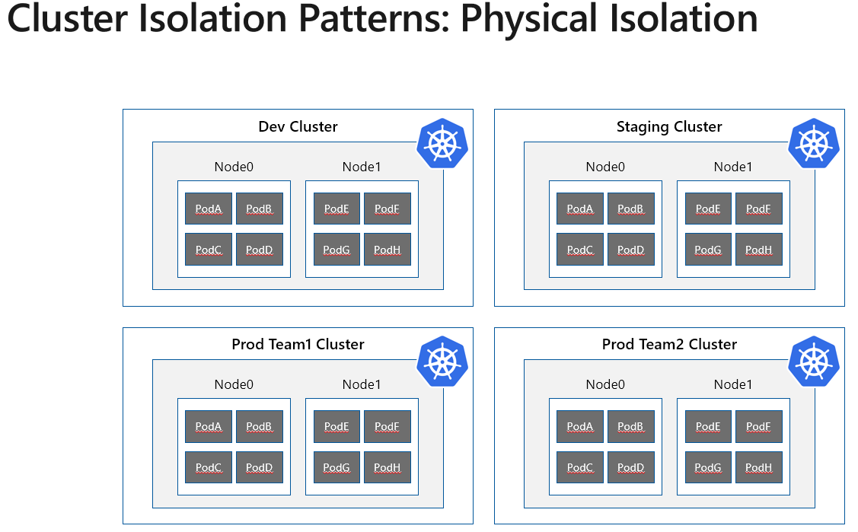

Slide 31
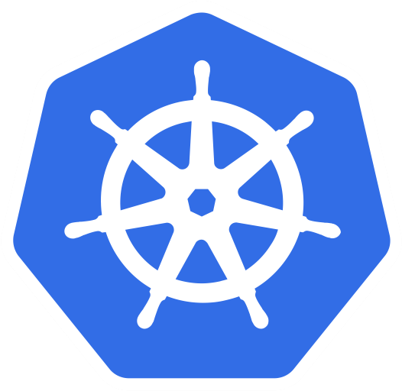
Cluster Isolation Patterns: Logical Isolation
Dev and Staging Cluster
Prod Cluster
Node0
Node1
Node0
Node1
DevTeam1
Team1
Pod
Pod
Pod
Pod
Pod
Pod
Pod
Pod
Pod
Pod
Pod
Pod
Staging
Pod
Pod
Pod
Pod
Team2
Node2
Node3
Node3
Node4
Pod
Pod
Pod
Pod
Pod
Pod
Pod
Pod
Pod
Pod
Pod
Pod
DevTeam2
Pod
Pod
Pod
Pod
Team3

Slide 32
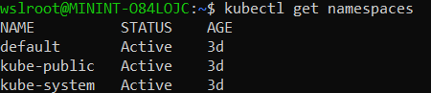
Namespaces
Namespace resource is the logical Isolation boundary
Provide a scope for names
Multiple virtual clusters backed by the same physical cluster
Every resource type is scoped to a namespace (except for nodes, persistentVolumes, etc.)
Not all objects are namespaces i.e. nodes and persistent volumes
Intended for environments with many users, teams, projects
Kube-system namespace for dashboard etc.

Slide 33
Isolation Dimensions
Resource Quotas.
Node Selectors , Taints and Tolerations.
Node Affinity, Pod Affinity and Anti-Affinity
Pod Budget Policies …
Scheduling
Authentication and Authorization
RBAC with AAD.
Pod Identity.
Secrets with Keyvault. ….
Network Policies
Networking
Containers
Scan images and runtime
Leverage Linux Capabilities
Pod security policy
Pod security context ….

Slide 34
Physical vs. Logical Isolation
Physical
Logical
Pod Density
Low to Medium
Medium to High
Cost
$$
$
Kubernetes Experience desired
Low to Medium
Medium to High
Security
High (Surface is small)
High*
Blast Radius of Changes
Small
Big
Management and Operations
Owner Team
Single or Cross Functional Team
Cost Management (Charge Back)
Billing Tags, Business as usual
Complex
*Logical Isolation via Namespaces can achieve hard isolation assuming the cluster admin has applied all the required security controls

Slide 35
Cluster Isolation - Summary
Think of the sensitivity of the workload, cost, organization culture, operations model, and blast radius, when trying to choose which isolation pattern to use, a mixture is fine too.
Always use Namespaces even in physical isolation, never use the Default Namespace for production workloads
Apply Resource Quotas

Slide 36


